Slide 1
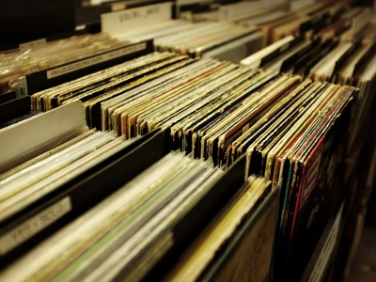
OGC API – Records – Part 1: Core, Version 1.0.0
Open Standards Code Sprint
March 2025
Panagiotis (Peter) A. Vretanos, CubeWerx Inc.
Tom Kralidis, Meteorological Service of Canada
Angelos Tzotsos, Open Source Geospatial Foundation
13 March 2025

Slide 2
Agenda
Review of common component requirements classes
Review of catalog requirements classes (deployments)
Deployment/"Common Component" matrix
Code sprint goals

Slide 3
Common Components

Slide 4










Common components requirements classes
Record Collection (Catalog)
JSON (Record encoded as GeoJSON Catalog encoded as JSON)
HTML (Record & Catalog encoded as HTML)
Record Core
Records API (uses Features API)
Filtering (CQL2)
Sorting
Record Core Query Parameters
(bbox, datetime, limit, q, type, ids, externalIds)
OpenAPI 3.0
AUTODISCOVERY (how to discover a catalog)

Slide 5
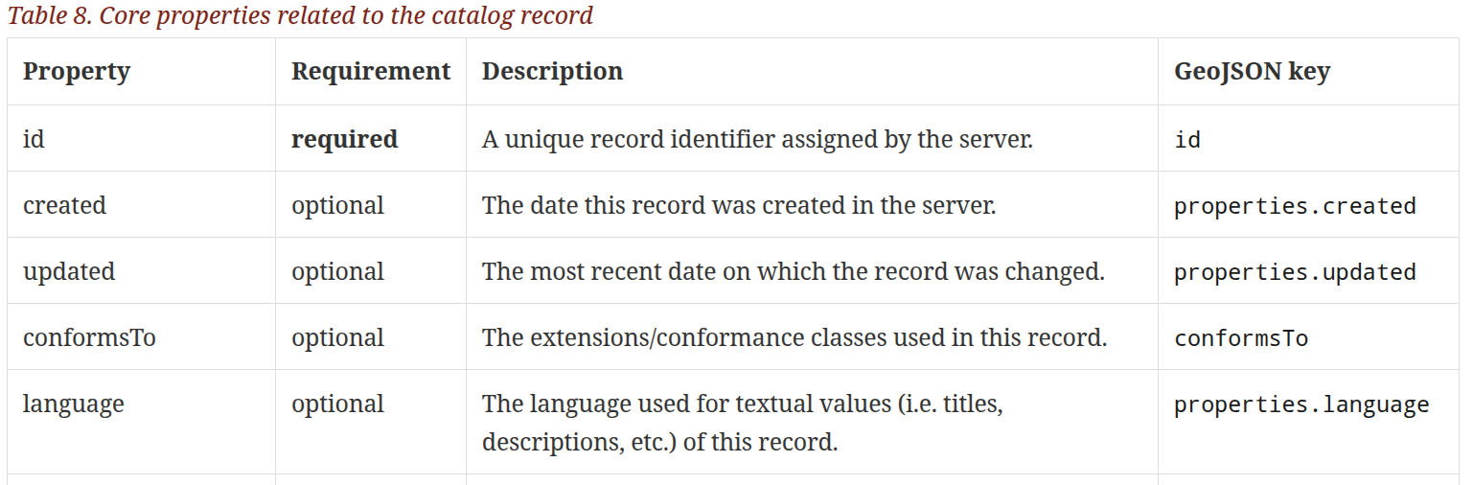
Record Core requirements class
A Record is the atomic unit of information in a catalog.
A Record provides a description of a resource to make it discoverable.
This requirements class defines the schema of Record.
HTML and GeoJSON encodings are defined; others allowed.

Slide 6
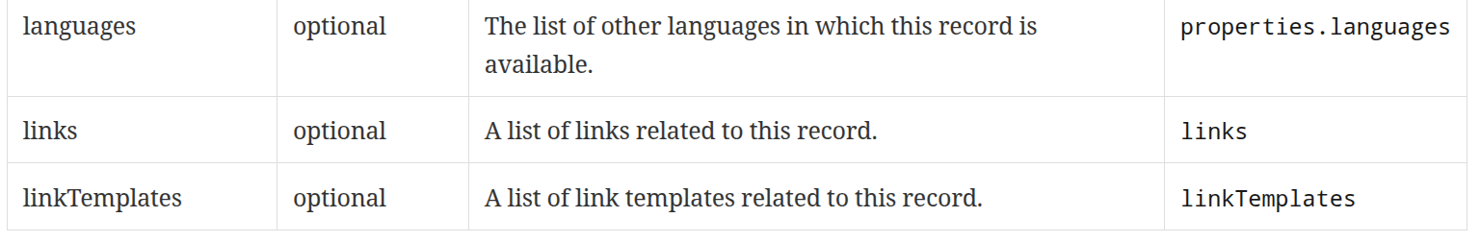
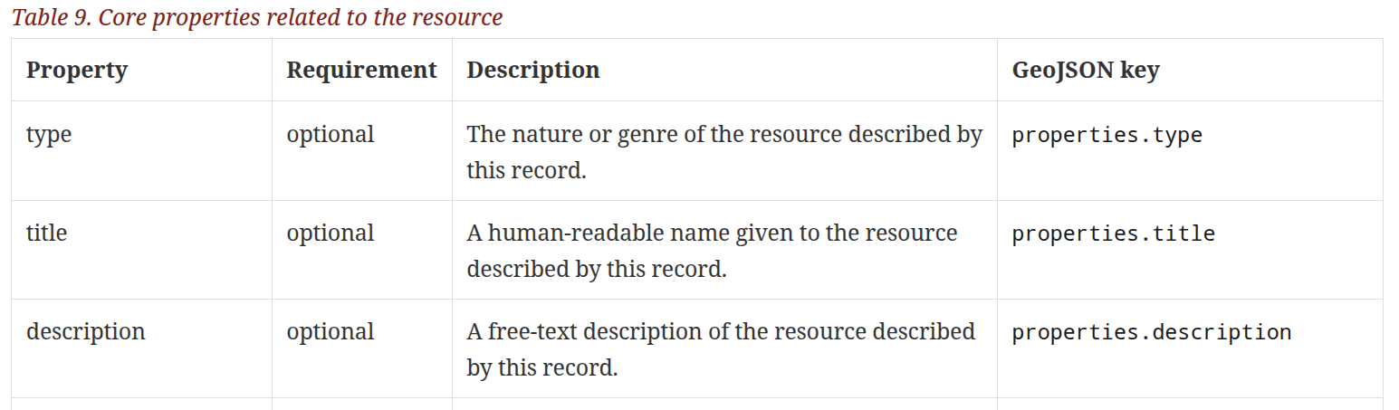
Record Core requirements class (cont.)

Slide 7
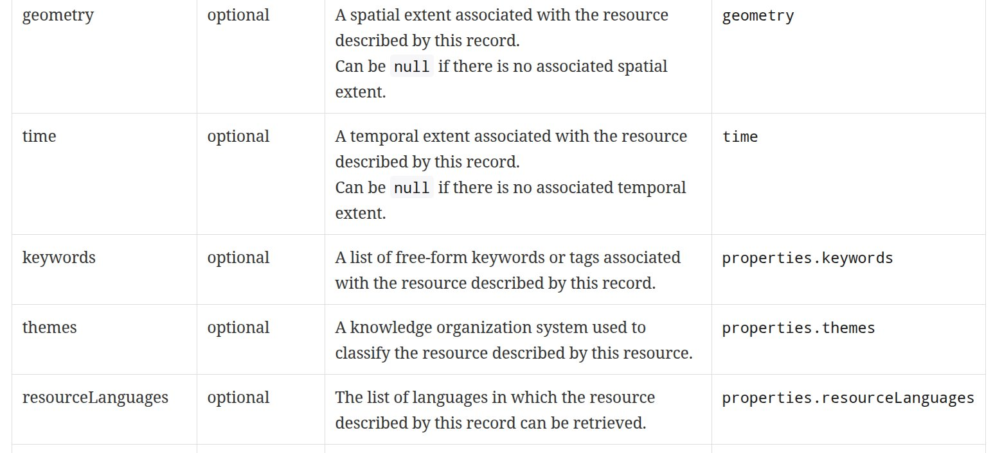
Record Core requirements class (cont.)

Slide 8
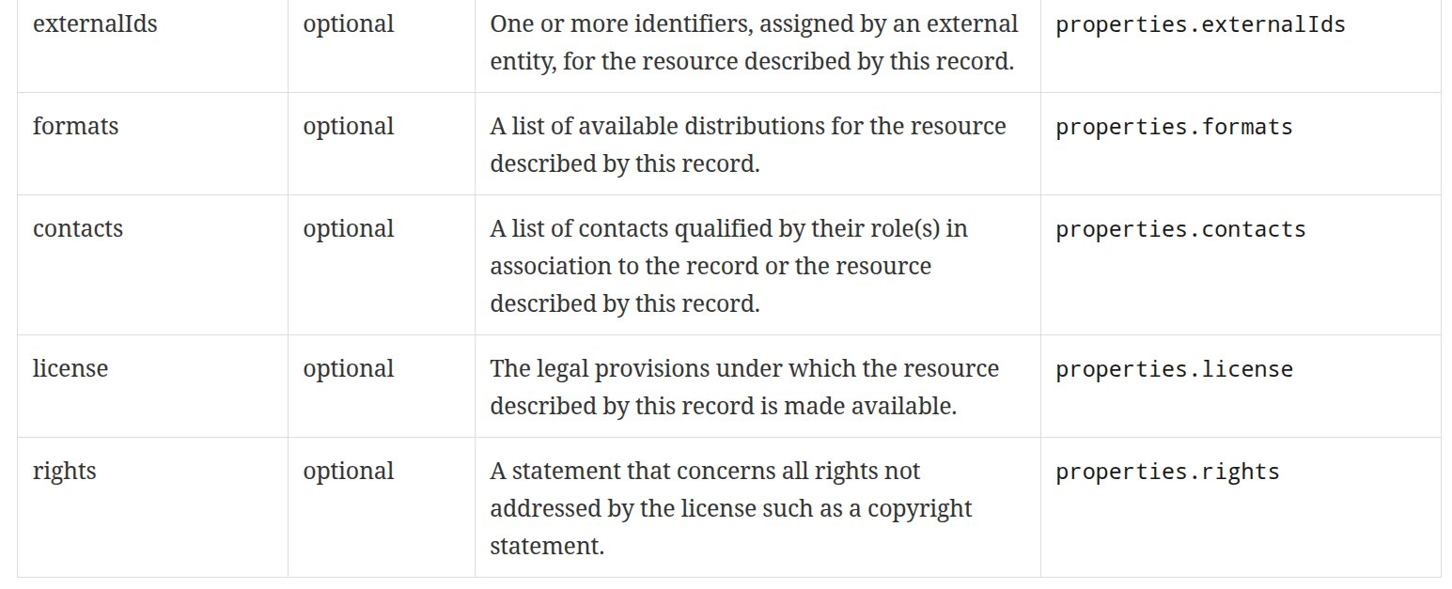
Record Core requirements class (cont.)

Slide 9
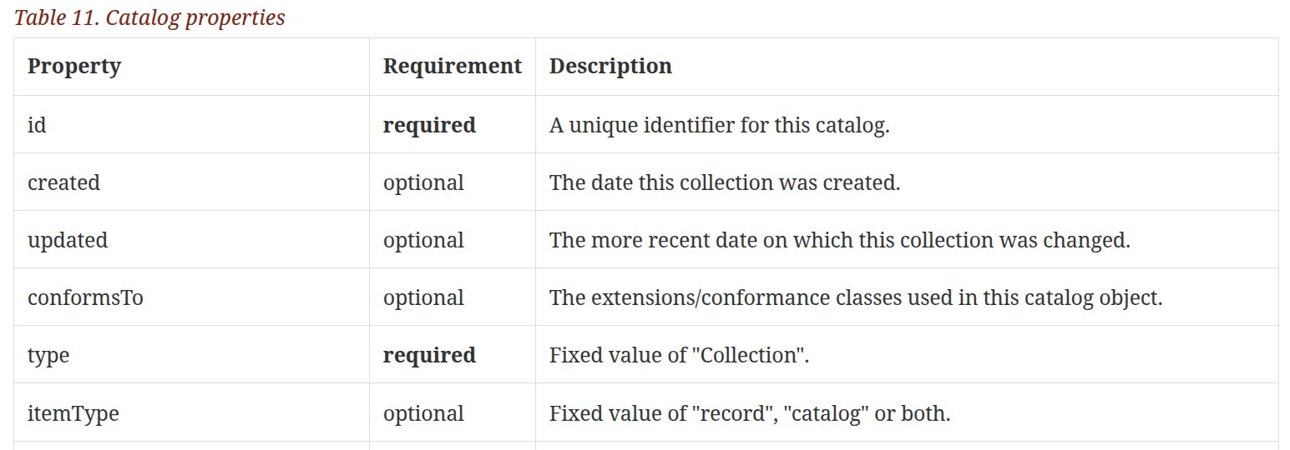
Record Collection requirements class
Defines the schema of an object that describes a catalog.
Based on the collection object from OGC API – Features: Part 1
This is essentially a Record that describes a Catalog.

Slide 10
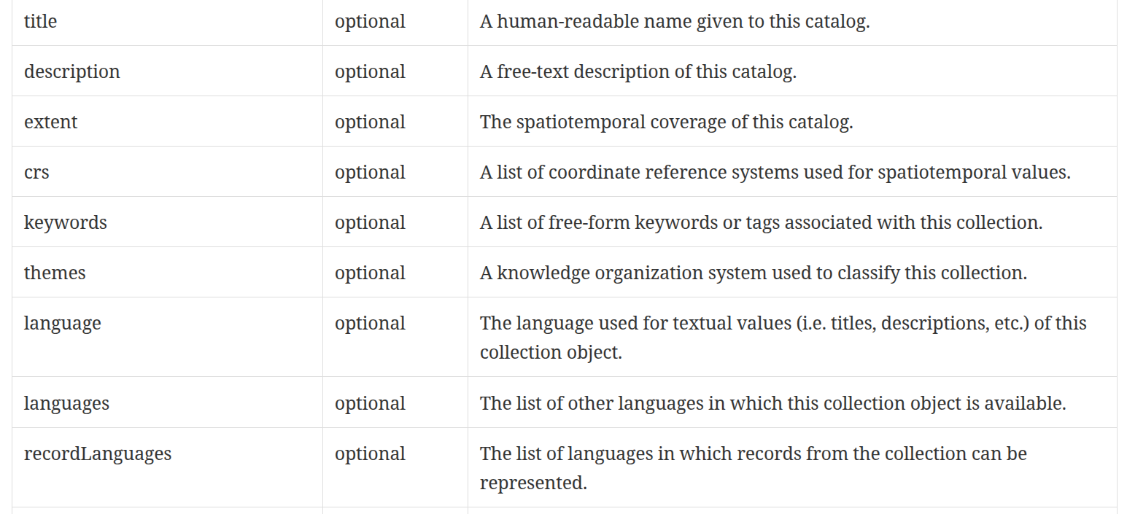
Record Collection requirements class (cont.)

Slide 11
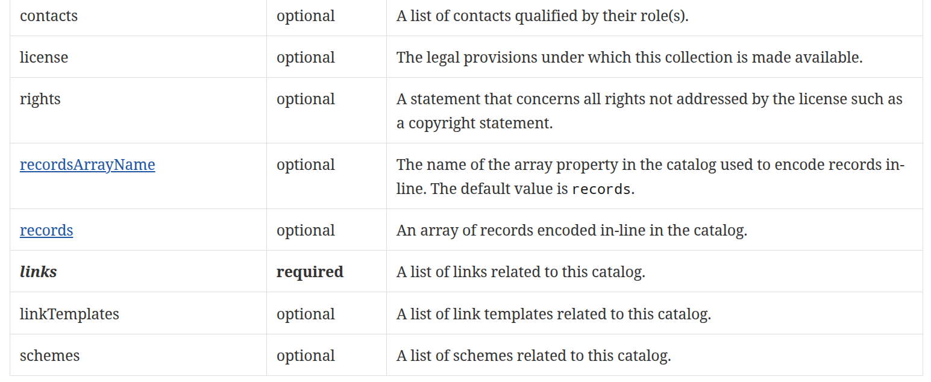
Record Collection requirements class (cont.)

Slide 12
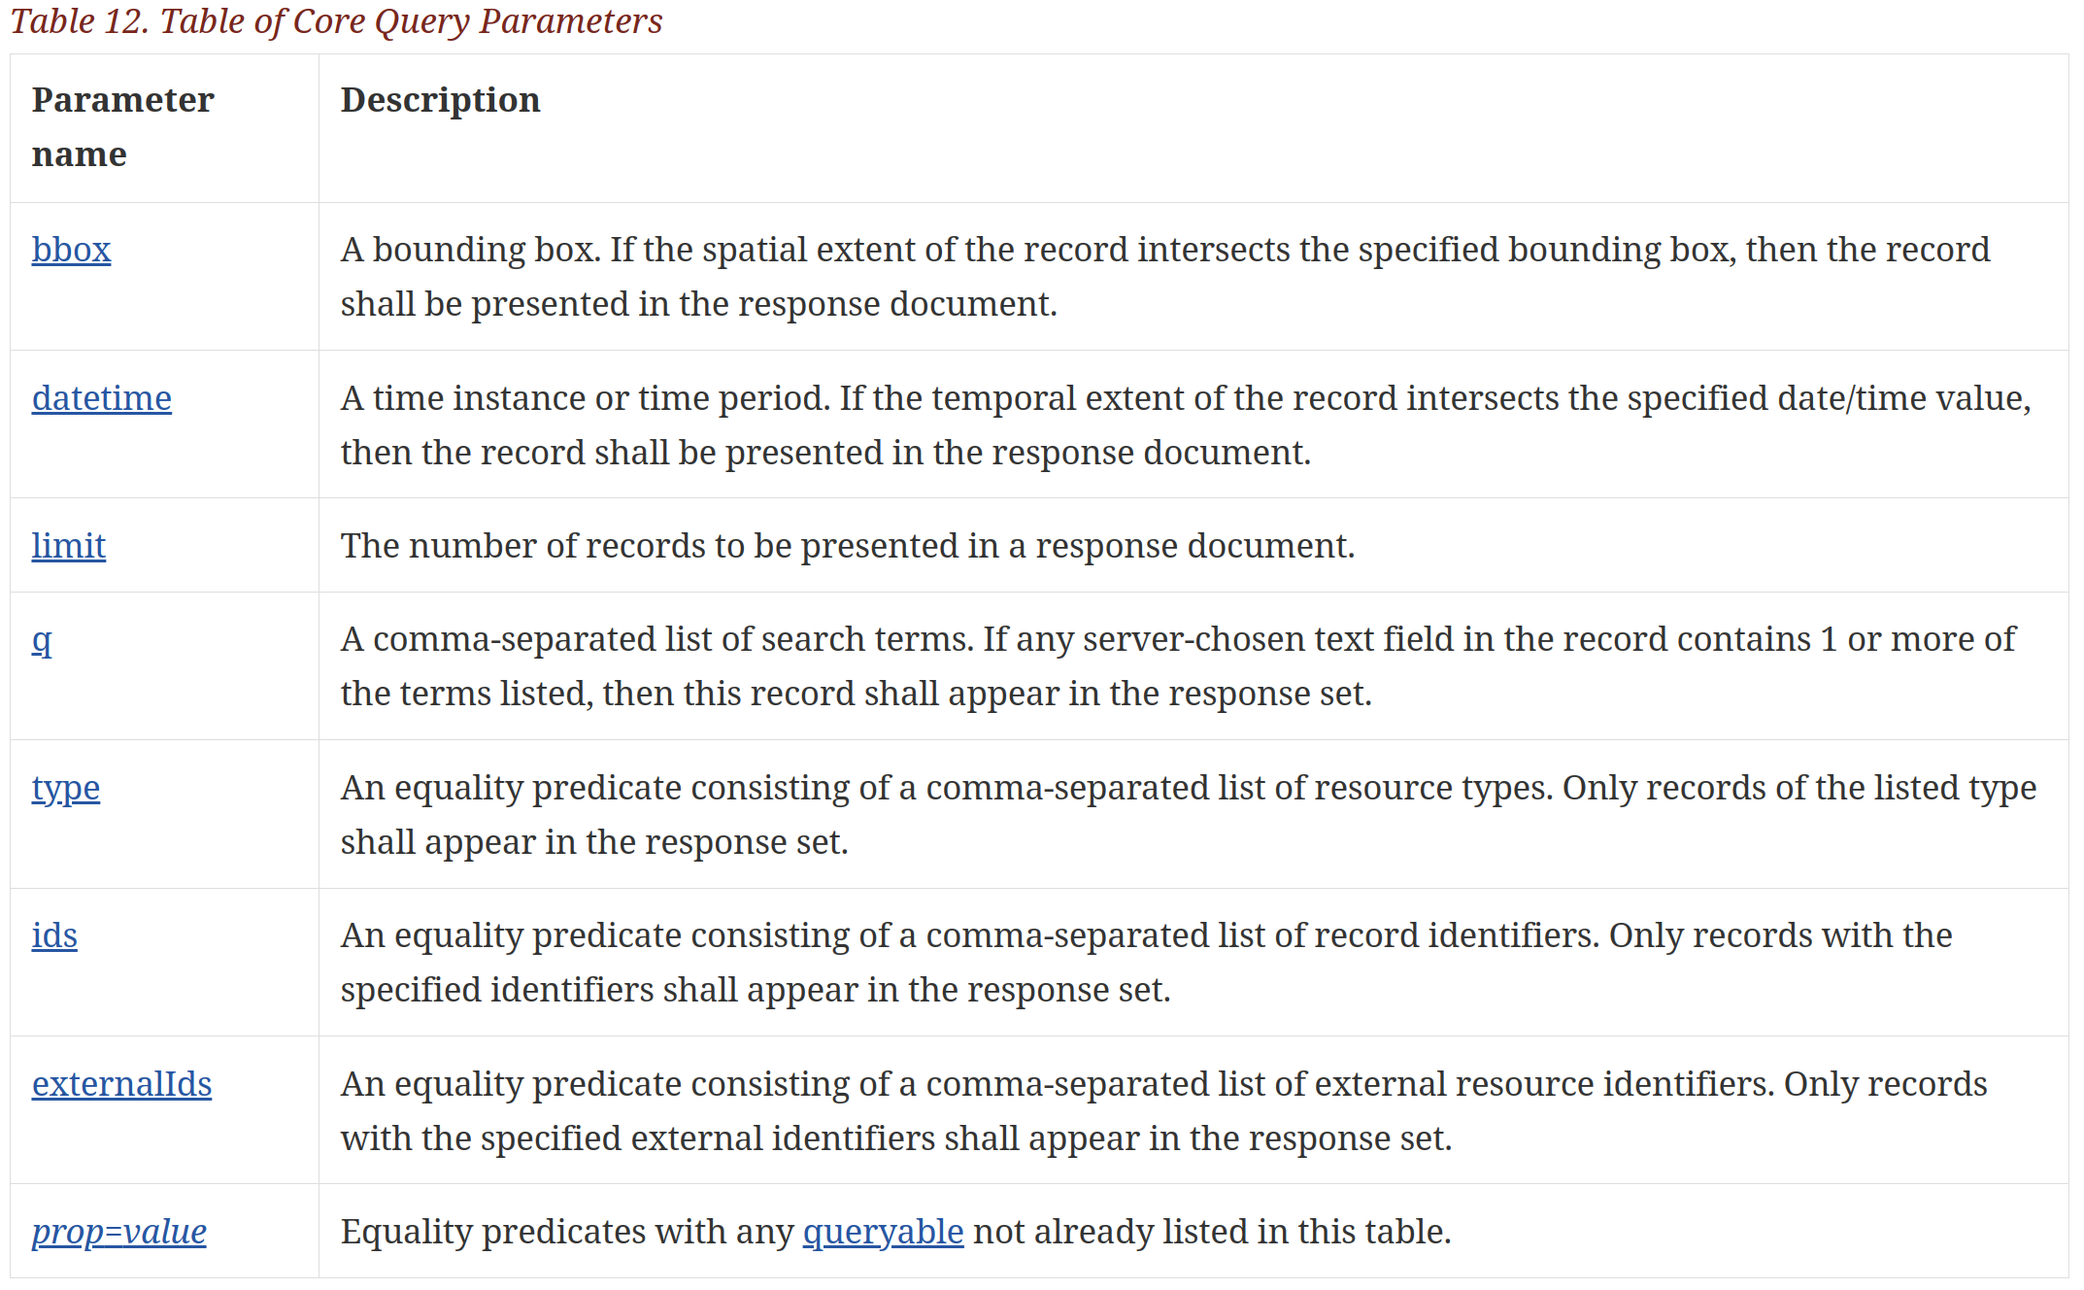
Record Core Query Parameters req. class
Defines set of query parameters to support basic catalog searching.
Based on OGC API – Features with additional catalog-specific parameters.

Slide 13
Records API requirements class
The Records Standard used the API defined in OGC API - Features.
Each reference to features or feature in the OGC API - Features Standards is replaced by the terms records or record when interpreting an OGC API - Features requirement for the Records API.
As defined in the Record Query Parameters requirements class, the Records Standard defines some additional query parameters (e.g. “q”).

Slide 14
Sorting requirements class
Defines the “sortby” query parameter.
The parameter is based on the same parameter defined by STAC.
.../collections/mycat/items?...&sortby=-updated,id&… (descending sort)
.../collections/mycat/items?...&sortby=+extent&...(ascending sort)
The requirements class also defines an endpoint at /collections/{collectionId}/sortables that can be used to determine which properties can be used for sorting.
The requirements class also extends the Record Collection requirements class to add "defaultSortOrder" parameter.
"defaultSortOrder": [ { "field": "updated", "direction": "desc" }, { "field": "area", "direction": "desc" } ],

Slide 15
Filtering requirements class
Defines the “filter”, “filter-lang” and “filter-crs” query parameters.
Recommends the use of CQL2-text and CQL2-json as the query language but other languages are allowed (e.g. OGC Filter Encoding).
Can be used in combination with the query parameters defined in the Record Query Parameters requirements class.
The implied logical operator in this case is AND.

Slide 16
HTML & JSON requirements classes
Defines the requirements for HTML and JSON Record Collection and Record responses.
JSON
There is a JSON schema defined for the Record Collection.
Media type: application/ogc-catalog+json
The JSON schema for Records is GeoJSON.
Media type: application/geo+json; application=ogc-record
HTML
Media type: text/html

Slide 17
OpenAPI 3.0 requirements class
Simply says that if you are implementing the Records API and are also using OpenAPI 3.0 to define your API, then all OpenAPI 3.0 requirements from OGC API – Features – Part 1: Core must be satisfied.

Slide 18
Autodiscovery requirements class
Defines the requirements for including one or more links in a Web page or landing page to enable the discovery of an associated catalog(s).
Uses the rel http://www.opengis.net/def/rel/ogc/1.0/ogc-catalog.
Can point to Searchable, Crawlable or Local Resources catalog endpoints.

Slide 19
Catalog Deployments

Slide 20
Catalog deployments
Using the common components three catalog types or deployments are defined in the standard
CRAWLABLE CATALOG
Static pages
Easy to implements
Crawlable using a browser or by a web crawler
SEARCHABLE CATALOG
“Traditional” catalog
Database backed
Dynamic search capability using simple and complex predicates (CQL2)
LOCAL RESOURCES CATALOG
Like a searchable catalog
Makes OGC API endpoints (e.g. /collections) searchable by catalog clients

Slide 21
Crawlable Catalog requirements classes
Crawlable Catalog
A catalog composed of statically deployed records typically co-located with the resources they describe.
The requirements class also defines a “collection object” that allows static collections of related records to be grouped together.
The “collection object” also support hierarchically organized collections of static records.
Very low implementation bar; easy to deploy, easy to use.

Slide 22




Crawlable catalog

Slide 23
Searchable Catalog requirements classes
Searchable Catalog
A basic queryable catalog using the API defined in OGC API – Features – Part 1: Core Standard with defined item schema and an extended set of catalog-specific query parameters (e.g. q, type, externalIds, etc.).
Searchable Catalog – Sorting
Optionally add the ability to sort catalog responses.
Searchable Catalog – Filtering
Optionally add an advanced query capability using logically connected query predicates.

Slide 24

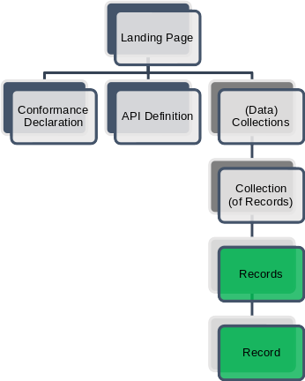


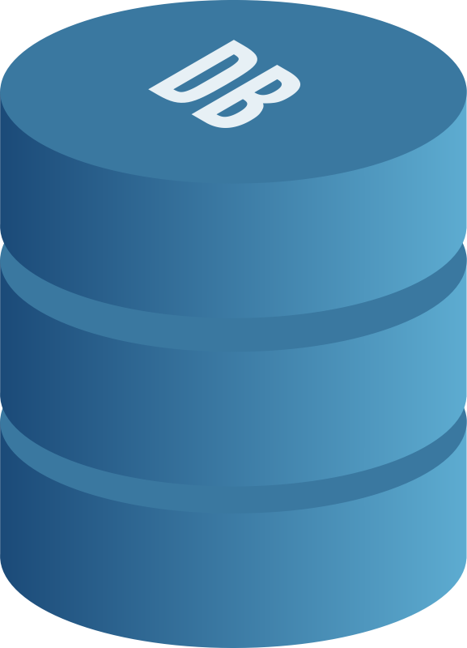


Searchable catalog
GET /collections/MyCat/items?bbox=-69.64,37.76,-56.12,46.63&datetime=2020-01-11T00:00:00/2020-01-12T00:00:00

Slide 25
Local Resources Catalog req. class
Local Resources Catalog
An existed endpoint defined by an OGC API Standard that has been extended to support catalog-like queries (e.g. the /collections endpoint).
Add additional properties from Record Core to the local resources object (e.g. the /collections/{collectionId} object).
Local Resources Catalog – Query Parameters
Optionally implement the set of Record Core Query Parameters to the local resources endpoint.
Local Resources Catalog – Sorting
Optionally add the ability to sort the response for the local resources endpoint.
Local Resources Catalog – Filtering
Optionally add an advanced query capability using logically connected query predicates (e.g. CQL2) at the local resources endpoint.

Slide 26



Local resources catalog (e.g. /collections)
GET /collections?bbox=-69.64,37.76,-56.12,46.63&datetime=2020-01-11T00:00:00/2020-01-12T00:00:00

Slide 27
Deployments & Components Matrix

Slide 28
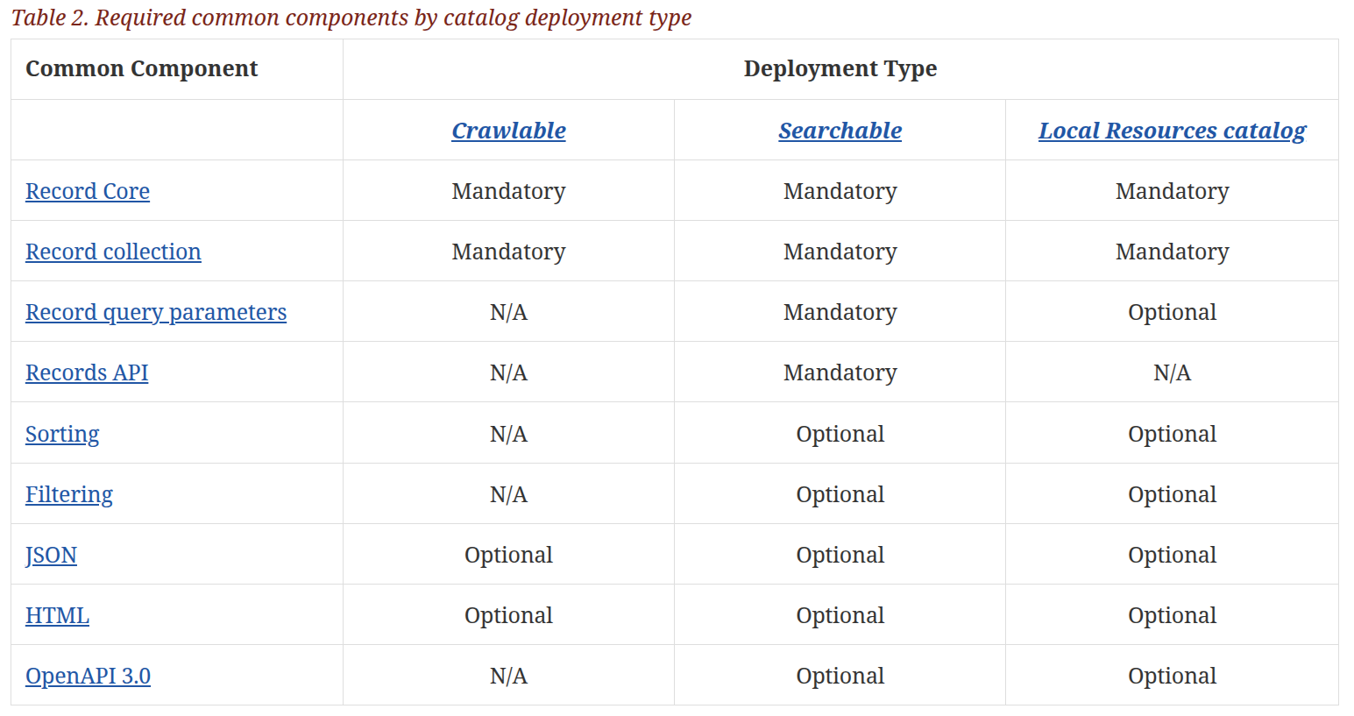
Deployments Common Components matrix

Slide 29
Code Sprint Goals

Slide 30
Code Sprint Goals
Standard testing
Crawlable catalog
Local resources catalog
New work items
Facets
Transactions / Harvesting
Federated Search
STAC Harmonization
How to incorporate STAC extensions into Records

Slide 31

Thank You

